Slide 1


Introduction to Data Analytics
Vaibhav P. Vasani
Assistant Professor
Department of Computer Engineering
K. J. Somaiya College of Engineering
Somaiya Vidyavihar University

Slide 2
Analytics vs Analysis
Are They Same ?
The answer is ‘No! they are not the same.
There is not much importance for both the terms Data Analytics and Data Analysis without the Data.

Slide 3
Data Analytics
Analytics is a technique of converting raw facts and figures into some particular actions by analyzing those raw data evaluations and perceptions in the context of organizational problem-solving and also with the decision making.
Analytics is the discovery and conversation of significant patterns in data.
Especially, precious in areas prosperous with recorded information, analytics depends on the simultaneous utility of statistics, computer programming, and operation lookup to qualify performance.
Analytics frequently favors data visualization to talk insight.
The aim of Data Analytics is to get actionable insights ensuing in smarter selections and higher commercial enterprise outcomes.

Slide 4
Data Analysis
It is the technique of observing, transforming, cleaning, and modelling raw facts and figures with the purpose of developing beneficial information and acquiring profitable conclusions.

Slide 5
Literally, “Analysis” is the detailed examination of the elements or structure of something.
On the other side “Analytics” is the systematic computational analysis of data or statistics.
Data Analysis is actually a subset of Data Analytics which helps us to understand the data by questioning and to collect useful insights from the information already available.

Slide 6
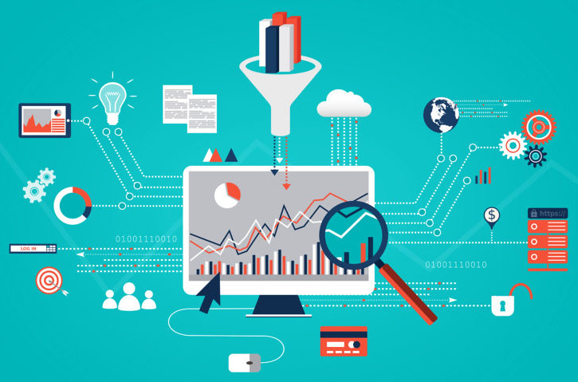
Notes:
Source: https://www.analyticsvidhya.com/blog/2021/05/data-analytics-vs-data-analysis-are-they-similar/#:~:text=Literally%2C%20%E2%80%9CAnalysis%E2%80%9D%20is%20the,analysis%20of%20data%20or%20statistics.

Slide 7
Data Analytics Vs Data Analysis
Sr. No. | Data Analytics | Data Analysis
1. | It is described as a traditional form or generic form of analytics. | It is described as a particularized form of analytics.
2. | It includes several stages like the collection of data and then the inspection of business data is done. | To process data, firstly raw data is defined in a meaningful manner, then data cleaning and conversion are done to get meaningful information from raw data.
3. | It supports decision making by analyzing enterprise data. | It analyzes the data by focusing on insights into business data.
4. | It uses various tools to process data such as Tableau, Python, Excel, etc. | It uses different tools to analyze data such as Rapid Miner, Open Refine, Node XL, KNIME, etc.
5. | Descriptive analysis cannot be performed on this. | A Descriptive analysis can be performed on this.
6. | One can find anonymous relations with the help of this. | One cannot find anonymous relations with the help of this.
7. | It does not deal with inferential analysis. | It supports inferential analysis.

Slide 8
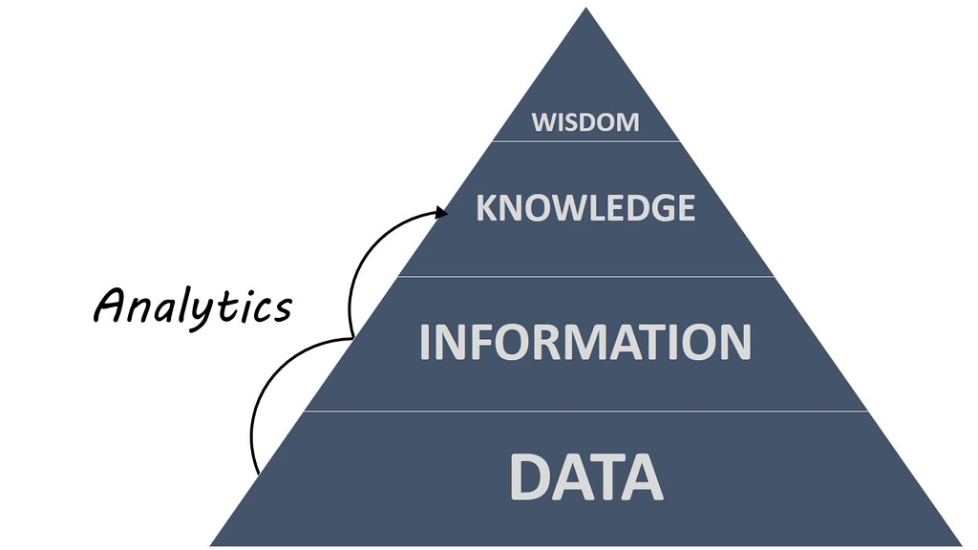

Slide 9
Tools and Process involved
The journey of Data Analytics consists of various stages including identifying the problem, finding the Data, Data Filtering, Data Validation, Data Cleaning, Data Visualization, Data Analysis, Inference, Prediction, etc. The most common tools employed in Data Analytics are R, Python, SAS, SPARK, Google Analytics, Excel, etc.
Similarly, the journey of Data Analysis comprises Data gathering, Data validation, Interpretation, Analysis, Results, etc., shortly it tries to find what the data is trying to express. The most common tools employed in Data Analysis are Tableau, Excel, SPARK, Google Fusion tables, Node XL, etc.

Slide 10


Slide 11
Analytics is commonly used in many distinct ways to find some strange patterns like finding the preferences, compute various correlations, trend forecastings, etc.
The most common real-life findings found through analytics are market trend forecastings, customer preferences, and effective business decisions.
With the help of Analysis, it is quite simple and easy to explore more valuable insights from the available data by performing the various types of Data Analysis such as Exploratory Data Analysis, Predictive Analysis, and Inferential Analysis, etc. They play a major role by providing more insights in understanding the data.

Slide 12
Example 1
Most probably before starting trading you just try to examine the past trend records of the shares in the share market to understand what happened so far in order to frame your strategies to get more profit right? This kind of process is an example of Data Analysis.
After understanding the trend of the shares, now you may use different techniques to predict the future price trend of the shares, and based on that you buy some shares right? This is an example process of Data Analytics.

Slide 13
What is business analytics?
Business analytics (BA) is a set of disciplines and technologies for solving business problems using data analysis, statistical models and other quantitative methods.
It involves an iterative, methodical exploration of an organization's data, with an emphasis on statistical analysis, to drive decision-making.

Slide 14
Data-driven companies treat their data as a business asset and actively look for ways to turn it into a competitive advantage.
Success with business analytics depends on data quality, skilled analysts who understand the technologies and the business, and a commitment to using data to gain insights that inform business decisions.

Slide 15
How business analytics works
Determine the business goal of the analysis.
Select an analysis methodology.
Get business data to support the analysis, often from various systems and sources.
Cleanse and integrate data into a single repository, such as a data warehouse or data mart.

Slide 16
Initial analysis is typically performed on a smaller sample data set of data.
Analytics tools range from spreadsheets with statistical functions to complex data mining and predictive modeling applications.
Patterns and relationships in the raw data are revealed.
Then new questions are asked, and the analytic process iterates until the business goal is met.

Slide 17
Deployment of predictive models involves a statistical process known as scoring and uses records typically located in a database.
Scores help enterprises make more informed, real-time decisions within applications and business processes.
BA also supports tactical decision-making in response to unforeseen events.
Often the decision-making is automated using artificial intelligence to support real-time responses.

Slide 18
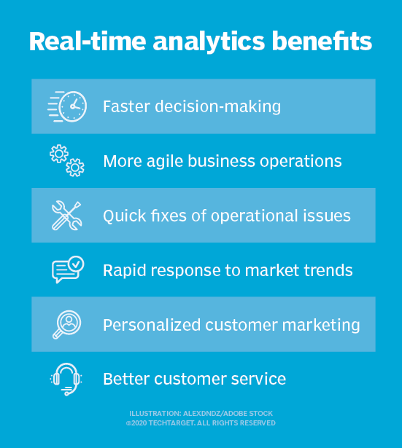

Slide 19
Type of Analytics
descriptive analytics,
predictive analytics
prescriptive analytics,
Diagnostic analytics,
Notes:
descriptive analytics, which tracks key performance indicators (KPIs) to understand the present state of a business;
predictive analytics, which analyzes trend data to assess the likelihood of future outcomes; and
prescriptive analytics, which uses past performance to generate recommendations for handling similar situations in the future.

Slide 20
descriptive analytics, which tracks key performance indicators (KPIs) to understand the present state of a business;
predictive analytics, which analyzes trend data to assess the likelihood of future outcomes; and
prescriptive analytics, which uses past performance to generate recommendations for handling similar situations in the future.
Diagnostic analytics, which is like descriptive analytics. It analyzes the state of a business and diagnoses why certain events or outcomes happened.

Slide 21
BI vs DA
What is happening now and why? (Business Intelligence)
What will probably happen next? (Data Analytics)

Slide 22

Business Intelligence vs Data Analytics As Seen Through Football
Notes:
Let’s say you’re on the coaching staff of a football team and you want to review the most recent game. You do this to see how you can fix your errors and replicate your successes.
Using our previous definitions, BI would be the process of identifying all the statistics and plays that led to your team winning. It would identify that you kept possession of the ball for much longer than your opponents. It would also identify the trend that your right side of the field was instrumental in retaining possession through excellent passing.
BA would be more concerned with why you had possession of the ball for longer than your opponent and why your right side of the field did so well at passing.
Was it because:
Your opponent’s defenders on that side were weaker players than their defenders on the other?
Your right-side players had been putting in more time on the field together than your left side?
One of your players on the right was simply having a phenomenal performance that carried over to the rest of that side?
These questions are important. They allow you to figure out how you can replicate your success, or prevent your failure hereafter. Asking the right business intelligence questions will lead you to better analytics. While using a business dashboard, all your information can be simplified into a single place, making the time for meaningful decisions much faster. But first, we need to analyze the difference more, as that will help us to understand what to do in a company’s operation process, and how to choose the best tool to manage your insights.

Slide 23
BI would be the process of identifying all the statistics and plays that led to your team winning.
It would identify that you kept possession of the ball for much longer than your opponents.
It would also identify the trend that your right side of the field was instrumental in retaining possession through excellent passing.

Slide 24
DA would be more concerned with why you had possession of the ball for longer than your opponent and why your right side of the field did so well at passing.
Was it because:
Your opponent’s defenders on that side were weaker players than their defenders on the other?
Your right-side players had been putting in more time on the field together than your left side?
One of your players on the right was simply having a phenomenal performance that carried over to the rest of that side?

Slide 25
Correlation Is Not Causation
When two things are correlated, it means that when one happens, the other tends to happen at the same time.
When two things have a causal relationship, it means that one thing leads directly or indirectly to the other happening.
A famous example of the difference between these two is the fact that ice cream consumption and city homicide rates are highly correlated.
Now, of course, ice cream does not cause people to murder each other. So clearly there is not a causal relationship.

Slide 26
Case
https://slate.com/news-and-politics/2013/07/warm-weather-homicide-rates-when-ice-cream-sales-rise-homicides-rise-coincidence.html

Slide 27
The two are correlated due to the fact that homicide rates rise when temperatures rise in the late summer.
It is theorized that since warmer weather brings more people outside, this leads to more social interaction, some of which is violent.

Slide 28
You Can’t Always Trust What You See

Slide 29
Read Yourself slide
You can find examples of people confusing correlation and causation everywhere you look.
For example, that muscular person at the gym who always likes to give you workout advice may or may not actually know what they are talking about.
The advice they’re giving you, while correlated with being known by a muscular person, may not actually lead to being muscular. Instead, they may simply have good genetics. They may be muscular not because of their knowledge, but actually in spite of it.

Slide 30
Read Yourself slide
There are some hilarious examples of things being correlated that clearly don’t have a causal relationship.
Many of them are shown on the website Spurious Correlations.
For example, divorce rates in Maine are very closely correlated with per capita consumption of margarine… Maybe married couples should switch to butter instead?

Slide 31
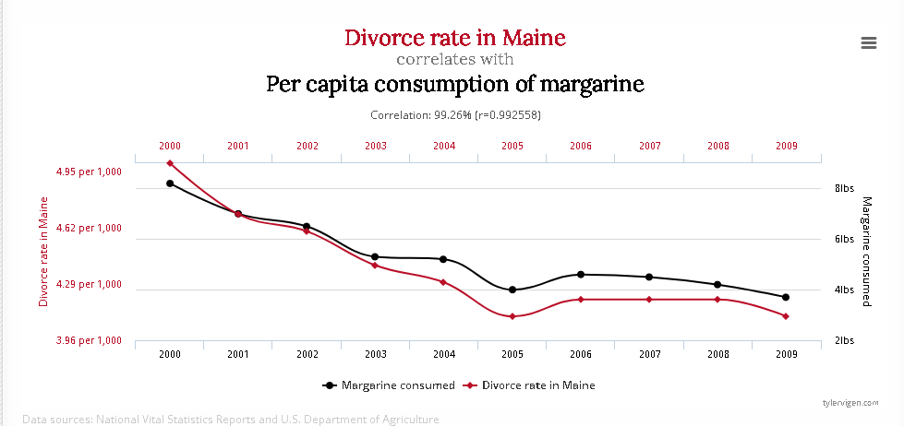
Source: Spurious Correlations

Slide 32
https://www.americanscientist.org/article/understanding-the-butterfly-effect

Slide 33
BI and DA Use-Case Scenarios?
Let’s say you work for a marketing firm that uses both business intelligence and analytics to help large e-commerce companies launch new products.
In order to understand what new products would be most likely to succeed (analytics), you would need to figure out:
What products had been most successful in the past (BI)
The seasonal trends that had influenced success for past launches (BI)
Why customers bought past successful products (DA)

Slide 34
For example, let’s say that your hypothetical e-commerce store sold boutique women’s fashion. You will need to work with your retail analytics to understand what products will work.

Slide 35
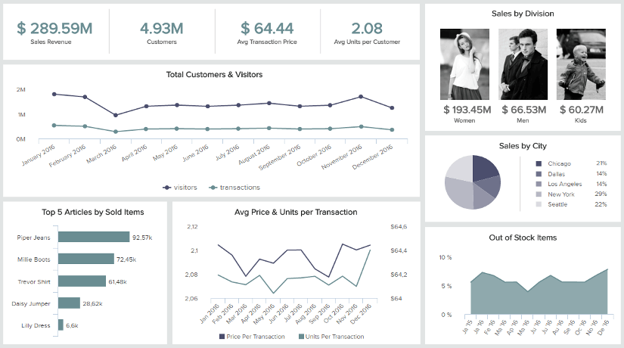

Slide 36
First, you would examine what categories of clothing are driving the most profits.
Then, you can examine what times in the year those successful products had been launched.
Finally, you could do a series of in-depth customer interviews in order to figure out why customers liked those pieces or categories more than the others.
If you did enough market research, and you had a large enough sample size, you should be able to predict with a great deal of accuracy which new products would be likely to succeed.
This could lead to surprises in the way that you think about your products because your customers often have a very different way of looking at your products than you do.

Slide 37
BI and DA Dismantle Assumptions
For example, maybe your assumption was that your customers mainly cared about the price point of your garments.
After your research, however, you found your customers were actually willing to spend more on your products if you emphasized your humane sourcing practices, such as not utilizing sweatshops.
Then, your focus would be on continuing to use that positioning in your marketing messages as opposed to worrying about the price points of your garments so much when doing a product launch.
The fundamental important points of BI and DA:
Your assumptions about your organization, your customers, your marketplace, and your products, are often flat out wrong – or at the very least, incomplete.
After asking the right questions, analytics are here to help – whichever your industry or sector

Slide 38
Common challenges of data analytics
Too many data sources
Lack of skills
Data storage limitations
Notes:
Too many data sources. There is an increasingly large spectrum of internet-connected devices generating business data. In many cases, they are generating different types of data that must be integrated into an analytics strategy. However, the more complex a data set becomes, the harder it is to use it as part of an analytics framework.
Lack of skills. The demand for employees with the data analytic skills necessary to process BA data has grown. Some businesses, particularly small and medium-sized businesses (SMBs), may have a hard time hiring people with the BA expertise and skills they need.
Data storage limitations. Before a business can begin to decide how it will process data, it must decide where to store it. For instance, a data lake can be used to capture large volumes of unstructured data.

Slide 39
Roles and responsibilities in Data/business analytics
Business analytics professionals' main responsibility is to collect and analyze data to influence strategic decisions that a business makes. Some initiatives they might provide analysis for include the following:
identifying strategic opportunities from data patterns;
identifying potential problems facing the business and solutions;
creating a budget and business forecast;
monitoring progress with business initiatives;
reporting progress on business objectives back to stakeholders;
understanding KPIs; and
understanding regulatory and reporting requirements.

Slide 40
Business analysts must have a mixture of hard and soft skills.
A business analyst does not need a deep understanding of IT but does need to understand how systems work together.
Some business analysts choose to move from an IT-centric role into a BA role.

Slide 41
Busting Business Analytics Myths
You Need Programming to Learn Business Analytics
You Need Advanced Maths for Business Analytics
Learning BA Tools And Techniques is Enough for Becoming a Good Business Analyst
A Business Analytics Profile Is All About Crunching Numbers
Notes:
You Need Programming to Learn Business Analytics – A professional doesn’t require programming experience to learn business analytics as most of the tools and techniques are easy to use. Tableau, a data visualization tool, even has drag and drop elements that make it really easy for anyone to get started. That’s why Business Analytics has found such ubiquitous application in all domains and professionals from vastly different industries like BFSI, Marketing, Agriculture, Healthcare, Genomics, etc. find it to be a great career option and a natural progression in their careers. A good knowledge of statistics will need to be developed though.
You Need Advanced Maths for Business Analytics – Is based on the use of common human intelligence that can be applied to solve any and all industry problem. Hence, you don’t need Fourier series or advanced mathematical algorithms to build analytical models. Math learned till 10+2 level is good enough and can serve as a starting base for professionals in all domains. Also, unknowingly a lot of professionals apply math in their day to day work with excel and data interpretation so Math beyond the basic level is not a mandate to learn the principles of business analytics.
Learning BA Tools And Techniques is Enough for Becoming a Good Business Analyst – While learning Python, R, or SAS can get you through the door for an interview, it would be fairly hard for anyone to excel in their role without two things – one is domain knowledge and the second would be a business sense. To understand a client’s (or your own internal) requirement, to formulate a problem statement that needs to be processed, a business analytics professional has a lot under his/her purview. Simply put, learning tools and techniques is only a small piece of the larger picture to get you started in your role. Dr. Bappaditya (Director, PG Program Business Analytics Program, Great Lakes) explains this with an example: “A million records of a customer for credit cards are processed to figure out bad customers from good ones. While a data scientist will crunch that data to find insights, a Business Analytics professional will put a decision rule to it. A business analyst will look at all this data and come to the simple rule that customer is good if his credit score is above this (let’s say 95%) or his income is above that and the number of dependents is this. Otherwise, a customer is bad. So, Business Analytics is much more applied and with a very specific objective in mind.
A Business Analytics Profile Is All About Crunching Numbers – Number crunching or in technical terms – cleaning of data, slicing and dicing of data, converting an unstructured data set into a structured one is all part of the process. However, the profile of a business analytics professional is not limited by these functions. The essence of true business analytics lies in resolving business problems combining domain knowledge, client interactions, business sense, and basic human intelligence apart.

Slide 42
Dr. Bappaditya (Director, PG Program Business Analytics Program, Great Lakes) explains this with an example:
“A million records of a customer for credit cards are processed to figure out bad customers from good ones. While a data scientist will crunch that data to find insights, a Business Analytics professional will put a decision rule to it. A business analyst will look at all this data and come to the simple rule that customer is good if his credit score is above this (let’s say 95%) or his income is above that and the number of dependents is this. Otherwise, a customer is bad. So, Business Analytics is much more applied and with a very specific objective in mind.

Slide 43
Business Analytics FAQs
1. What is business analytics in simple words?
In simple words, business analytics is a process through which businesses make use of various technologies and statistical methods to analyze data to help in gaining new insights that can further help in decision-making.
2. What do business analytics do?
Business Analytics have numerous responsibilities. They work on utilizing statistical data, big data, and data visualization to aid in business decision and implementing organizational changes. They also help in predicting outcomes based on insights and taking informed decisions.
3. What are the 3 types of business analytics?
The three main types of business analytics are:
Descriptive Analytics
Predictive Analytics
Prescriptive Analytics
4. What are examples of business analytics?
Business Analytics is used in almost every industry today. Some of the real-world examples of business analytics are developing marketing strategies, increasing sales, improving financial efficiency, streamlining processes, increasing productivity, and using predictive analytics.

Slide 44
5. Is business analytics a good career?
Yes, business analytics is a good career. Organizations depend on Business Analysts to provide valuable insights that can be helpful in decision making. Business analytics professionals are required in all industries, be it financial institutions or e-commerce sites. Upskilling in the field of business analytics can help you power ahead your career.
6. How difficult is business analytics?
The learning outcomes may vary from one individual to another. Some may find business analytics difficult and some might be able to grasp the concepts easily. However, choosing the right format of learning (online courses, video tutorials, books, etc.), will help make it easier. Choosing the right online courses which mentor guidance will surely help make the process easier.
7. Is business analyst an IT job?
A combination of technical skills such as statistical analysis software’s, SQL and database query languages, data mining, data visualization, business intelligence, and soft skills are required for a business analyst. IT Business Analyst is one of the career paths you can take up as a business analyst.
8. Does business analytics require coding?
Business Analytics is more statistics oriented. However, some of these tools may include SQL, Python, and thus having some coding and programming knowledge is required. Depending on the company and your job description, the requirements may vary.
9. What skills are needed for business analyst?
Some of the skills needed for business analysts are:
Analytical and problem solving
Oral and written communication proficiency
Basic programing language knowledge
Business structure understanding
Cost-Benefit Analysis
Statistical analysis software (e.g. R, SAS, SPSS, or STATA)

Slide 45
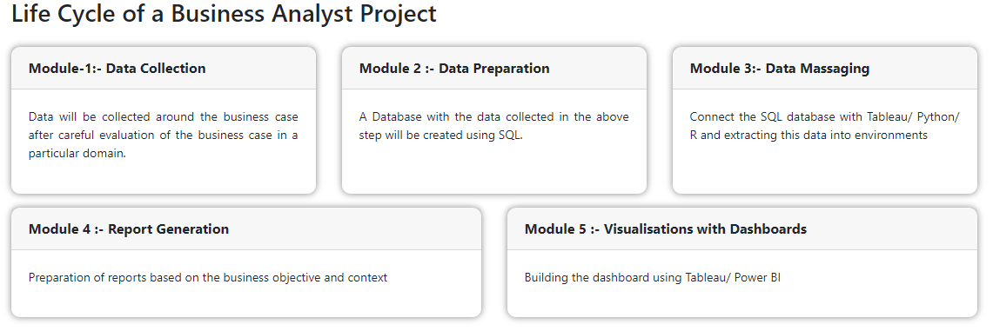
Source: (excelr.in)

Slide 46
There are 5 Courses in this Specialization
Customer Analytics
Operations Analytics
People Analytics
Accounting Analytics
Business Analytics Capstone

Slide 47
Skills Every Business Analytics Professional Needs
A good communicator
Inquisitive
A problem solver
A critical thinker
A visualizer
Both detail-oriented and a big picture thinker
Statistical languages
Statistical software**
SQL***
Source : (hbs.edu)

Slide 48
Data for Data Analytics
Data are numerical facts and figures that are collected through some type of measurement process.

Slide 49
Data are used in virtually every major function in a business.

Slide 50
Some examples of how data are used in business include the following:
Annual reports summarize data about companies’ profitability and market share both in numerical form and in charts and graphs to communicate with shareholders.
Accountants conduct audits to determine whether figures reported on a firm’s balance sheet fairly represent the actual data by examining samples (that is, subsets) of accounting data, such as accounts receivable.
Financial analysts collect and analyze a variety of data to understand the contribution that a business provides to its shareholders. These typically include profitability, revenue growth, return on investment, asset utilization, operating margins, earnings per share, economic value added (EVA), shareholder value, and other relevant measures.

Slide 51
Some examples of how data are used in business include the following:
Economists use data to help companies understand and predict population trends, interest rates, industry performance, consumer spending, and international trade. Such data are often obtained from external sources such as Standard & Poor’s Compustat data sets, industry trade associations, or government databases.
Marketing researchers collect and analyze extensive customer data. These data often consist of demographics, preferences and opinions, transaction and payment history, shopping behavior, and a lot more. Such data may be collected by surveys, personal interviews, focus groups, or from shopper loyalty cards.
Operations managers use data on production performance, manufacturing quality, delivery times, order accuracy, supplier performance, productivity, costs, and environmental compliance to manage their operations.
Human resource managers measure employee satisfaction, training costs, turnover, market innovation, training effectiveness, and skills development.

Slide 52
Such Data Gathered from primary sources such as internal company records and business transactions, automated data-capturing equipment, or customer market surveys and from secondary sources such as government and commercial data sources, custom research providers, and online research.

Slide 53
the most important source of data today is data obtained from the Web.
With today’s technology, marketers collect extensive information about Web behaviors, such as the number of page views, visitor’s country, time of view, length of time, origin and destination paths, products they searched for and viewed, products purchased, what reviews they read, and many others.

Slide 54
Question
?
Notes:
https://www.datapine.com/blog/difference-between-business-intelligence-and-analytics/
https://www.mygreatlearning.com/blog/what-is-business-analytics/

Slide 55
Business Analytics | Coursera

